Slide 1
FHIM Value Proposition

Slide 2
What is FHIM
FHIM is a logical health information model that specifies computable semantic interoperability of observations with explicit context and harmonizes information requirements from federal partners and standards organizations
Supports intra-agency, inter-agency, and healthcare industry interoperability
Provides an integrated picture of a data model, standards information, common data elements, standard reference terminologies and code sets, and architectural tools needed to design applications using various HL7 standards such as CDA documents and FHIR resources.
An information model is needed to create Electronic Healthcare Records, and FHIM serves as the blueprint

Slide 3
How FHIM Provides Benefit
The FHIM delivers a vetted view of the highly complex and ever changing healthcare environment
Inspected through collaborative Modeling and Terminology meetings through the participation of federal and industry Subject Matter Experts.
FHIM Model Driven Development is an open architecture and available via github and Eclipse licensing
Provides a single point of reference to ensure consistent updating of healthcare information requirements based on changes in healthcare laws, regulations, policies, and standards.
FHIM offers comprehensive data structures, terminology and tools to build and maintain healthcare interoperability solutions.
Notes:
Modeling Process The broad set of health information that falls within the scope of the FHIM is sub-divided into over 40 different information domains. Information domains are prioritized and modeled essentially in order of their priority. A temporary work effort is established to model an information domain. Federal partners who participate in the work effort bring their use cases and information requirements to the effort. Additionally, the information requirements of standards organizations are addressed. The modeling process that produces the FHIM harmonizes the information requirements across the federal partners and standards organizations to produce a single, harmonized information model. Terminology Terminology and value set requirements are discussed concurrently with the information modeling effort and are formally modeled and defined once the information model is essentially complete. Currently we are binding terminology to the FHIM. This includes content from the Public Health Information Network's (PHIN) Vocabulary Access and Distribution System (PHIN VADS). This is a terminology server maintained by the CDC.

Slide 4
FHIM Value Opportunities
Can be used as part of TEFCA to specify QHIN interoperability
Proposed HL7 project to leverage FHIM as an HL7 reference domain analysis model
Can be used as a primary component of the information layer of an enterprise architecture
Can be used to harmonize and standardize information across organizational elements and initiatives within a department
Can be used as part of contract specifications to harmonize and standardize information in contractor generated databases with information in other existing organizational databases

Slide 5
Supporting Interoperability
The 21st Century Cures Act (Cures Act) defines interoperability in the context of health information technology as it
enables the secure exchange of electronic health information with, and use of electronic health information from, other health information technology without special effort on the part of the user;
allows for complete access, exchange, and use of all electronically accessible health information for authorized use under applicable State or Federal law; and
does not constitute information blocking as defined in section 3022(a).
You cannot use information that you don’t understand- this is where FHIM provides the most value as it translates and transforms between multiple standards and protocols, as required by TEFCA Qualified Health Information Networks

Slide 6
How FHIM Supports the 2018-2022 HHS Strategic Plan
Strategic Goal 1: Reform, Strengthen, and Modernize the Nation's Healthcare System
FHIM supports ONC’s USCDI Common Data Elements empowering TEFCA QHIN interoperability
Value based care’s requires data quality across Healthcare IT.
FHIM curated data quality is the lynchpin of Healthcare IT value (patient safety, care-quality, lower-cost)
FHIM’s clinical goal is to help people live the healthiest lives possible by enabling a “Learning Health System” supporting areas such as, but not limited to, Rural Healthcare, Telemedicine, Precision Medicine, Research, etc.
Developers and users want faster and cheaper approaches. FHIM supports better data stewardship & interoperability.
CIMI-FHIM Model Driven Development (MDD) creates consistent FHIR, C-CDA templates and V2 message
MDD artifacts empower consistent and traceable Trusted Exchange Framework and Common Agreement (TEFCA)
USCDI and CIMI-FHIM empower TEFCA Qualified Healthcare Information Networks (QHIN) interoperability
Strategic Goal 2: Protect the Health of Americans Where They Live, Learn, Work, and Play
Modernized Nation’s Healthcare Systems are Knowledge Based System protecting Americans in every environment.
Strategic Goal 3: Strengthen the Economic and Social Well-Being of Americans Across the Lifespan
Patient values empowers the entire healthcare ecosystem with faster, better and cheaper knowledge based systems.
Strategic Goal 4: Foster Sound, Sustained Advances in the Sciences
consistent and requirements traceable CIMI-FHIM data and information empowers knowledge and wisdom development.
Strategic Goal 5: Promote Effective and Efficient Management and Stewardship
Efficient and effective CIMI-FHIM MDD methodologies empower faster-better-cheaper management and stewardship..
Notes:
In January 2018, Health and Human Services (HHS) Office of the National Coordinator (ONC) released the Trusted Exchange Framework and Common Agreement (TEFCA) and U.S. Core Data for Interoperability (USCDI) draft policy documents. They promise profound impact on the activities and priorities of Health Information Networks (HINs), provider organizations that participate in HINs and HIT vendors and service providers. TEFCA and
USCDI will define US policy for interoperability, when finalized around December 2018.
TEFCA strives to establish a single Healthcare Information Exchange (HIE) “on-ramp” to enable providers, hospitals and other healthcare stake-holders to join within the nationwide health information exchange (NHIN). TEFCA establishes “Qualified HINs” (QHINs) as a vehicle to facilitate a standardized methodology for NHIN connectivity. This methodology is managed by a Recognized Coordinating Entity (RCE).
USCDI begins with the Common Clinical Data Set (CCDS) required by ONC’s 2015 Certification Criteria; where, USCDI adds classes (data modules) for structured-and-unstructured Clinical Notes and for Provenance (who, what, when, where, why, how). USCDI outlines a roadmap to include additional classes and data elements categorized as
mature, where, established standards exist, that become USCDI inclusion candidates.
Immature, where, terminology, controlled vocabularies and code sets are evolving.

Slide 7
How FHIM Supports the NLM 2017-2027 Strategic Plan
A Platform for Biomedical Discovery and Data-Powered Health
Strategic Goal 1: Accelerate Discovery and Advance Health through Data-Driven Research
CIMI-FHIM Model Driven Development (MDD) creates consistent FHIR, C-CDA templates and V2 message
Consistent data representations is critical to cross-study data-driven research
Use of data models and clinical content that have an ontologic core supports general-to-specific clinical queries
Re-use of existing proven models brings faster results
FHIM supports ONC’s USCDI Common Data Elements empowering TEFCA QHIN interoperability
Drives consistency and broadens data repository support between research and bedside
Provides an implementation framework for USCDI requirements
Developers and users want faster and cheaper approaches. FHIM supports better data stewardship & interoperability.
CIMI-FHIM Model Driven Development is an open architecture and available via github and Eclipse licensing
USCDI and CIMI-FHIM empower TEFCA Qualified Healthcare Information Networks (QHIN) interoperability
Strategic Goal 2: Reach More People in More Ways through Enhanced Dissemination and Engagement
Modernized TECFA QHINs can reach and protect people in every environment with knowledge based systems.
Patient values empowers the entire healthcare ecosystem with faster, better and cheaper knowledge based systems.
Strategic Goal 3: Build a Workforce for Data-Driven Research and Health
Consistent and requirements traceable CIMI-FHIM information eases learning and comprehension of clinical models.
Notes:
In January 2018, Health and Human Services (HHS) Office of the National Coordinator (ONC) released the Trusted Exchange Framework and Common Agreement (TEFCA) and U.S. Core Data for Interoperability (USCDI) draft policy documents. They promise profound impact on the activities and priorities of Health Information Networks (HINs), provider organizations that participate in HINs and HIT vendors and service providers. TEFCA and
USCDI will define US policy for interoperability, when finalized around December 2018.
TEFCA strives to establish a single Healthcare Information Exchange (HIE) “on-ramp” to enable providers, hospitals and other healthcare stake-holders to join within the nationwide health information exchange (NHIN). TEFCA establishes “Qualified HINs” (QHINs) as a vehicle to facilitate a standardized methodology for NHIN connectivity. This methodology is managed by a Recognized Coordinating Entity (RCE).
USCDI begins with the Common Clinical Data Set (CCDS) required by ONC’s 2015 Certification Criteria; where, USCDI adds classes (data modules) for structured-and-unstructured Clinical Notes and for Provenance (who, what, when, where, why, how). USCDI outlines a roadmap to include additional classes and data elements categorized as
mature, where, established standards exist, that become USCDI inclusion candidates.
Immature, where, terminology, controlled vocabularies and code sets are evolving.

Slide 8
The Future of FHIM
FHIM is a key component needed to establish a reference domain analysis model (RDAM) for healthcare at HL7.
FHIM is referenced by NIEM Community for NIEM Exchanges that include health elements.
FHIM supports and can operationalize the US Core Data for Interoperability (USCDI) content.
Specifies a common set of data classes required for interoperable exchange and identifying a predictable, transparent, and collaborative process for achieving the goals of the 21st Century Cures Act.

Slide 9
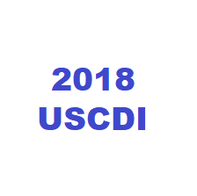
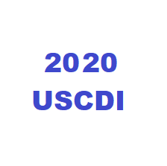
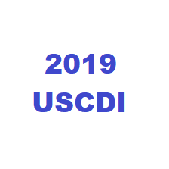
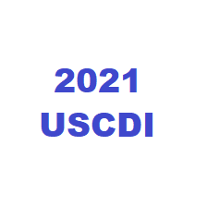
FHIM’s Coverage of USCDI
FHIM covers 19 of the 22 USCDI “Data Classes”
Remaining 3 Are on track to be modeled by DATE
All 4 of the Candidate Data Elements are already modeled in FHIM.
FHIM has modeled 4 of the 10 Candidate Data Elements
Remaining 6 have been partially modeled, or are easy to incorporate
All 5 of the Candidate Data Elements are already modeled in FHIM.
May flush out some concepts depending on necessary detail for “Provider Goals and Priorities”
Notes:
The FHIM covers 19 of the 22 USCDI Version 1 “Data Classes”.
Missing: Assessment and plan of treatment; Procedures; and Clinical Notes
All in the near-term plans for upcoming FHIM modeling.
Of the 10 USCDI Version 2 (2019) Candidate Data Elements, the FHIM has modeled 4 of them. Several of the remaining 6 have been partially modeled, or are relatively easily incorporated. The only one that might be difficult is the discharge instructions, if this is to be modeled as more than a large collection of text.
All 4 of the USCDI Version 3 (2020) Candidate Data Elements have been modeled in the FHIM.
All 5 of the USCDI Version 4 (2021) Candidate Data Elements have been modeled in the FHIM, although the depending on the details of what’s in the “Provider Goals and Priorities” there may need to be some fleshing out of some of the FHIM concepts accordingly.

Slide 10
Back-Up Slide

Slide 11

FHIM, Health IT Implementers Guide
How FHIM Supports Interoperability
Collection of healthcare data elements that:
Binds to terminologies
References Standards
Illustrates Relationships
Generate FHIR profiles that reflect realm-specific requirements (e.g., ONC, CMS regs & directives).

Slide 12
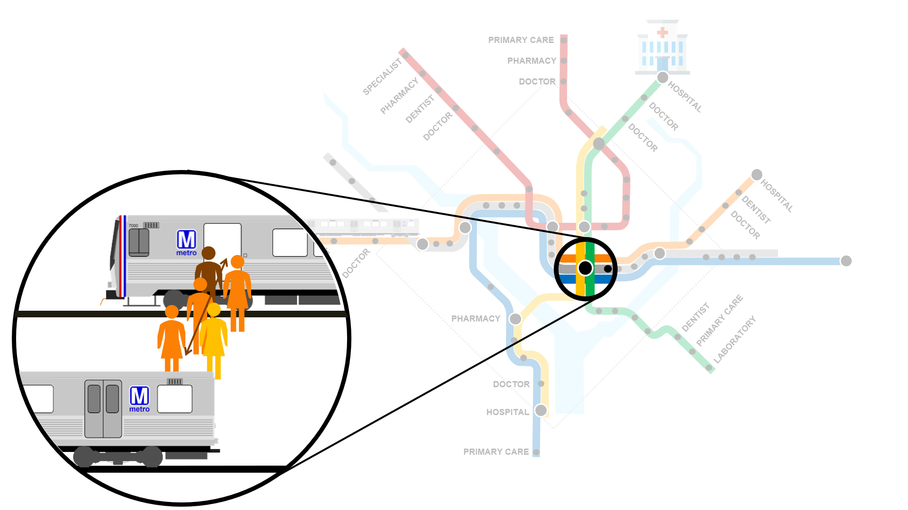
Health IT Analogy
How FHIM Supports Interoperability
If the Health IT ecosystem were a subway system of a large city…
FHIM is…
The blueprint - Defining how passengers will need to move, what lines will stop where and specifies how the trains should be built.
Trip planner - instructing passengers on which line to take to get to their destination and all stops along the way.
Maintenance tools- allowing for reliable, smooth and uniform rails on which to travel.
Subway Lines- Health Exchange networks
Stations- Participants (ie. providers, payors, hospital)
Train- Secure Gateways (ie. CONNECT or Direct)
Passengers- Clinical Health Data
Notes:
The healthcare IT system is a complex environment where health information needs to be shared among thousands of participants such as providers, payers, researchers, and beneficiaries.
Much like a subway system that moves passengers from one location to another, the healthcare environment has a similar framework that can be used to illustrate how health information is shared.
FHIM
The blueprint A trip planner
Tools that

Slide 13

USCDI Data Classes – FHIM and Standards Incorporation table
USCDI Data Classes | V | #¹ | FHIM | Term. | CDA | C-CDA | FHIR | X12 | VSAC
Patient name | 1 | 1 | Included |  |  | Yes | Yes
Sex (birth sex) | 1 | 1 | Included |  |  | Yes | Yes
Date of Birth | 1 | 1 | Included |  |  | Yes | Yes
Preferred Language | 1 | 1 | Included |  |  | Yes | Yes
Race | 1 | 1 | Included |  |  | Yes | Yes
Ethnicity | 1 | 1 | Included |  |  | Yes | Yes
Smoking Status | 1 | 1 | Included |  |  | Yes | Yes
Laboratory tests | 1 | ~80 | Included |  |  | Yes | Yes
Laboratory values/results | 1 | ~80 | Included |  |  | Yes | Yes
Vital signs | 1 | ~45 | Included |  |  | Yes | Yes
Problems | 1 | ~75 | Included |  |  | Yes | Yes
Medications | 1 | ~95 | Included |  |  | Yes | Yes
Medication Allergies | 1 | ~20 | Included |  |  | Yes | Yes
Health concerns | 1 | ~75 | Included |  |  | Yes | Yes
Care Team members | 1 | ~40 | Included |  |  | Yes | Yes
Assessment and plan of treatment | 1 | ~40 | Planned |  |  | Yes | Yes
Immunizations | 1 | ~60 | Included |  |  | Yes | Yes
Procedures | 1 | ~30 | Planned |  |  | Yes | Yes
UDI | 1 | ~40 | Included |  |  | Yes | Yes
Goals | 1 | ~95 | Included |  |  | Yes | Yes
Provenance | 1 | ~25 | Included |  |  | Yes | Yes
Clinical Notes | 1 | ~60 | Planned |  |  | Yes | Yes
V1-2018 | v2-2019 | v3-2020 | v4-2021

Slide 14
USCDI Data Classes – FHIM and Standards Incorporation table
USCDI Data Classes | v | #¹ | FHIM | Term. | CDA | C-CDA | FHIR | X12 | VSAC
Admission and Discharge Dates and Locations | 2 | ~20 |  |  |  | Yes | Yes
Cognitive Status | 2 | ~40 |  |  |  | Yes | Yes
Encounter | 2 | ~180 |  |  |  | Yes | Yes
Discharge Instructions | 2 | ~60 |  |  |  | Yes | Yes
Family Health History | 2 | ~40 |  |  |  | Yes | Yes
Functional Status | 2 | ~20 |  |  |  | Yes | Yes
Gender Identity | 2 | 10 |  |  |  |  | Yes
Pediatric Vital Signs | 2 | ~45 |  |  |  |  | Yes
Pregnancy Status | 2 | ~10 |  |  |  | Yes | Yes
Reason for Hospitalization | 2 | 1 |  |  |  | Yes | Yes
Care Provider Demographics | 3 | ~100 | Included |  |  | Yes | Yes
Care Team Members Contact Information | 3 | Incl | Included |  |  | Yes | Yes
Care Team Member Roles/Relationships | 3 | Incl. | Included |  |  | Yes | Yes
Diagnostic Image Reports (DIR) | 3 | ~85 | Included |  |  | Yes | Yes
Individual Goals and Priorities | 4 | incl | Included |  |  | Yes | Yes
Practitioner Responsible for Care | 4 | incl | Included |  |  | Yes | Yes
Provider Goals and Priorities | 4 | ~30 | Included* |  |  | Yes | Yes
Reason for Referral | 4 | ~5 | Included |  |  | Yes | Yes
Referring or Transitioning Provider’s Name and Contact Information | 4 | incl | Included |  |  | Yes | Yes
1 number of concepts in the data class. “incl:” = the data class is included in another data class
V1-2018 | v2-2019 | v3-2020 | v4-2021

